Slide 1


Computer Workshop
An Introduction
Dr. MalekiMajd
Notes:
- Greet and welcome the new students
- Ask if there are any non-new students

Slide 2
End goals
Get to know Must-know tools/topics/philosophies for a CE student
Using topics on a day-to-day basis
Getting students into the “Geeky” mindset

Slide 3
Syllabus
Intro (Today)
Git
LaTeX
HTML/CSS
GNU/Linux + Bash
Clean Code
?
Notes:
- Some subjects might be presented by others for new mindsets and vision
- The amount of sessions for each topic depends on the complexity of the topic
- Extra videos might be released for further studying
- The goal is to give a short intro to all the topics, further studying is needed if the student is interested

Slide 4
Grading System
Homework:
  Introduction (1 Point)
  Git (3 Points)
  LaTeX (3 Points)
  GNU/Linux + Bash (3 Points)
  Clean Code (2 Points)
  HTML/CSS (3 Points)
Final Project (5 Points)
Extra Points (∞ Points)
Notes:
- The course is designed not to be theoritical
- Homework is the main source to get good grades
- Extra points are given at every subject and they provide infinite amount of points. (Our goal is to make you explore further down the rabbit hole)

Slide 5
Attendance Policy
Students are required to attend 75% of the classes
Extra points is given to students with high attendance
Lectures provide insights that are not entirely in the slides

Slide 6
Introduction
What are going to talk about today?
  Touch typing
  How to learn new things as a student
  IDEs vs Text Editors
  Debugging
  Basic command line knowledge

Slide 7
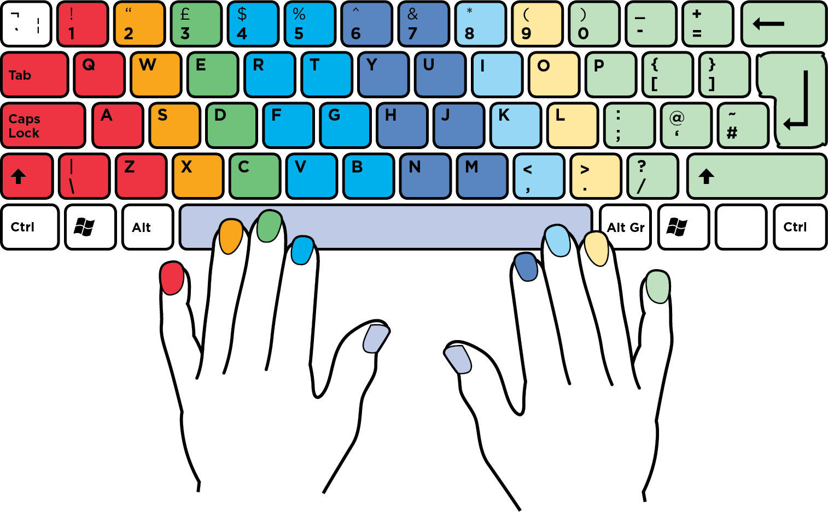
Touch typing
Notes:
- Very crucial for the career of a CE student
- Increases performance and productivity
- Involves typing without looking at the keyboard and utilizing all the fingers
- Everyone must learn this skill as a student

Slide 8
Why learn touch typing?
Code without thinking on the keyboard
Comfort
Increased productivity
It’s a must in professional workspaces
Notes:
- Note that in a professional workspace, if you lack the basic requirement of touch typing, they might wonder what other basic things you are missing

Slide 9
Tools to learn
Keybr.com (Learn finger by finger)
Monkeytype.com (Improve typing speed)
Typeracer.com (Race with others!)
10fastfingers.com

Slide 10
Touch typing
All students are advised to learn it
✨ Extra Point:
Manage to reach +60WPM by the end of the semester
(Using all the fingers is required)

Slide 11
How to learn new things as a CE student
Proficiency in English is required
  Can be achieved through day-to-day interaction with English
Don’t be afraid to read
  Documentations: first-hand instructions on how to use the software provided by the developers themselves
  Books
Notes:
- Students might suffer reading new content in their first few months but reading outweighs other methods

Slide 12
Learning via videos
Might be effective as an introduction
Due to the nature of the video format, it might not contain all the information
Reading is advised for further studying
Notes:
Videos might become boring to some after a period of time, causing the student not to learn properly

Slide 13
Demo
Let’s see learning more about the printf function in C in action!

Slide 14


IDE (integrated development environment)
Preconfigured environment for development
No need to install extra things
Usually comes with a cost
May be bloated for daily use

Slide 15



Text editors
Usually needs further configuration
Install only what you need
Good community support
Snappier/faster for daily use
May be hard to setup

Slide 16
Vim
a highly configurable text editor built to make creating and changing any kind of text very efficient.
It forces you to use the keyboard for maximum efficiency
It is highly configurable by nature
Free and Open Source
Nvim (Neovim), its popular fork, combined with the power of Lua, provides extra functionality.

Slide 17
Demo
Usage of neovim in day-to-day enviroment

Slide 18
Getting started with vim
Learn vim with
  iggredible/Learn-Vim in GitHub
  Any interactive “Learn vim” website
  …
Get in the Vim environment
  Using Nvim (LunarVim)
  Using the Vim extension inside VsCode (Demo)

Slide 19
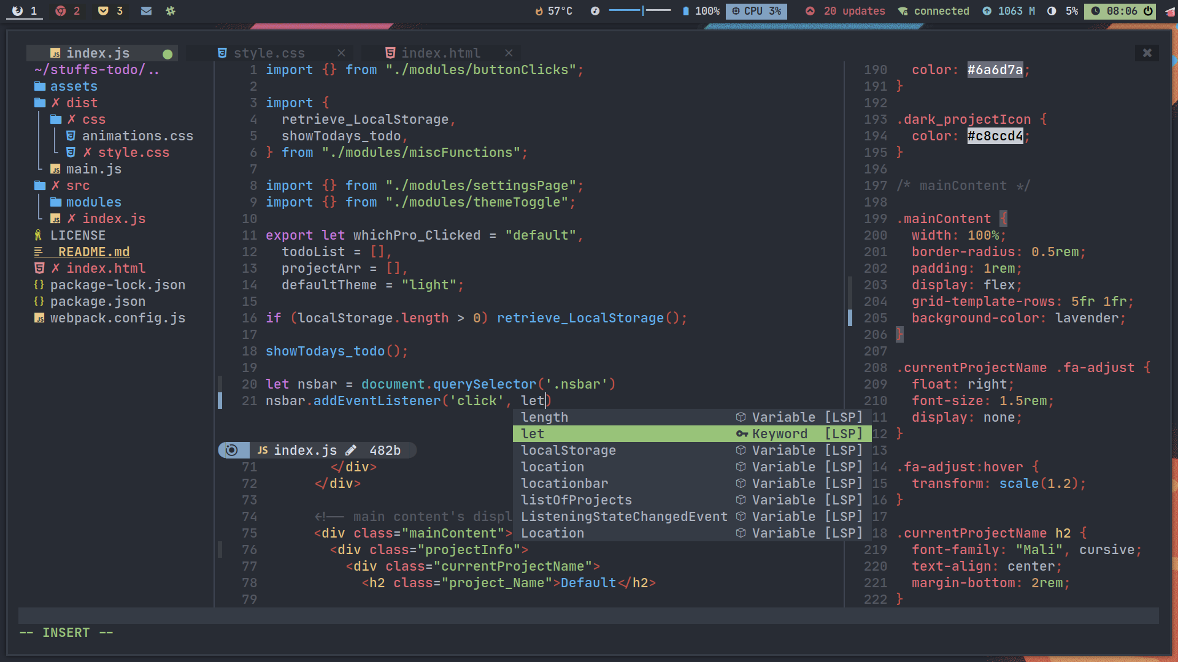
Gallery

Slide 20
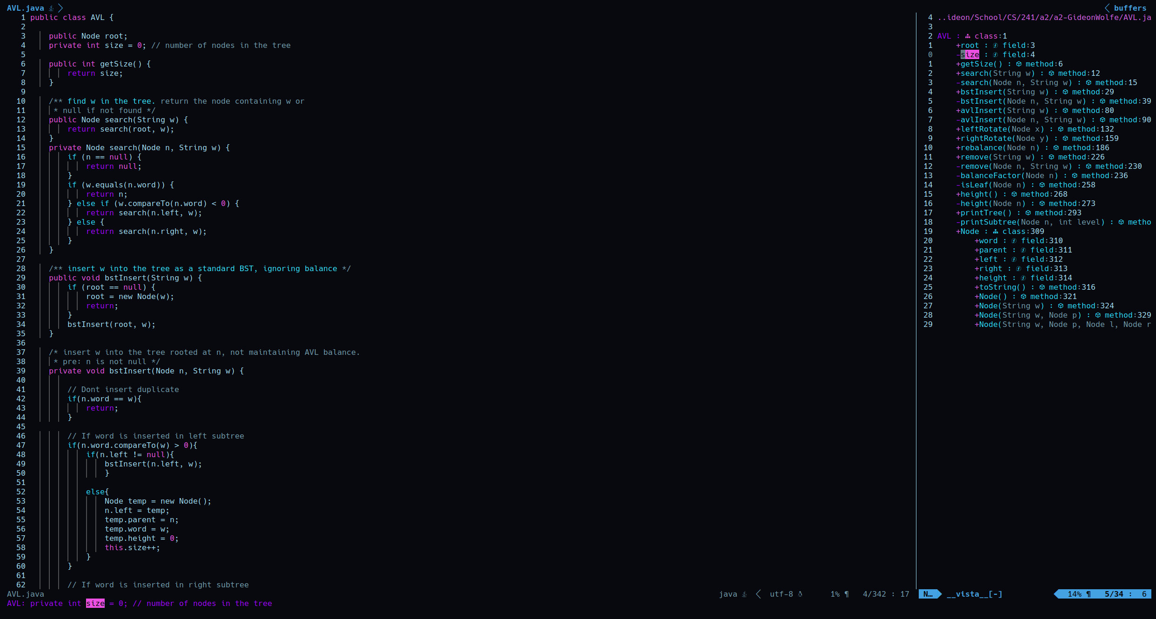
Gallery

Slide 21
Extra points!
Get very fluent in the vim workflow by the end of this semester!

Slide 22
Debugging
The process of finding and fixing the errors or bugs in the source code of your software
Local debugging: debugging on the current workstation
Remote debugging: debugging on a workstation that is on another network

Slide 23
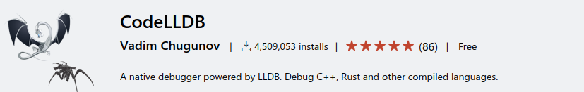
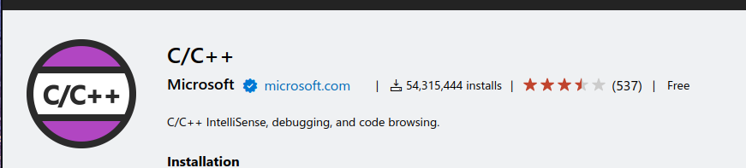
Getting started in debugging
Make sure CodeLLDB extension is installed in VsCode

Slide 24
Debugging analogy
Breakpoints: tell your debugger where to stop (to see the state of your program in the given point)
Variables: the value of the variables in the current scope
Watch: special variables you would like to have in your watch-list
Call stack: See where your bug came from

Slide 25
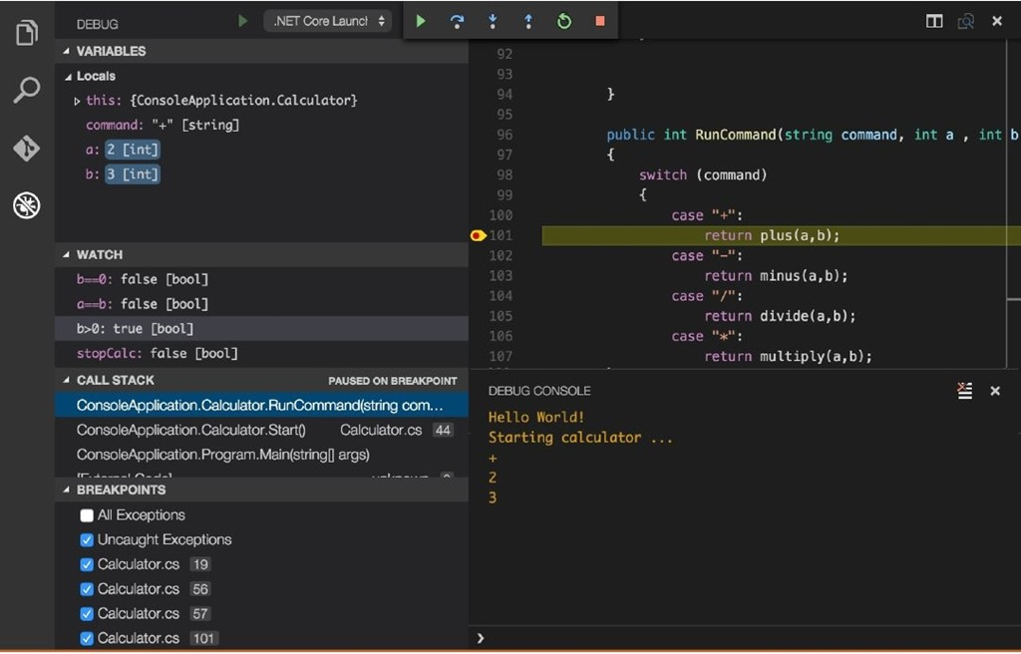

Slide 26
Debugging process
Set breakpoints where you think your program might be causing a bug/error.
Start the debugger and use the appropriate tools to find the root of the issue.
Provide a fix for the issue

Slide 27
Moving around
Continue: resume running the program until the end of the program/hits a break-point
Step into: debug step by step, even if it means going into the stack (function)
Step over: debug step by step, but don’t go further into the stack (function)
Step out: Continue the execution until it exits the current stack (function)

Slide 28
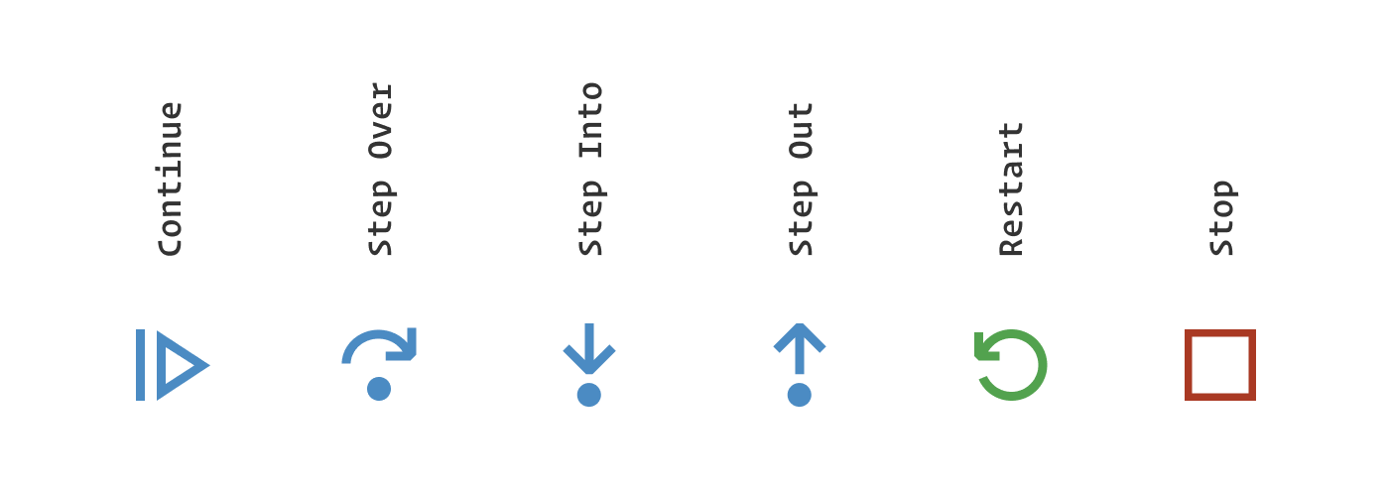
Debugging icons

Slide 29
A simple debugging problem
Imagine we want to calculate the following using a simple C program but our results don’t match our expectations. Let’s do a simple debugging step by step to see where we have made a mistake.

Slide 30
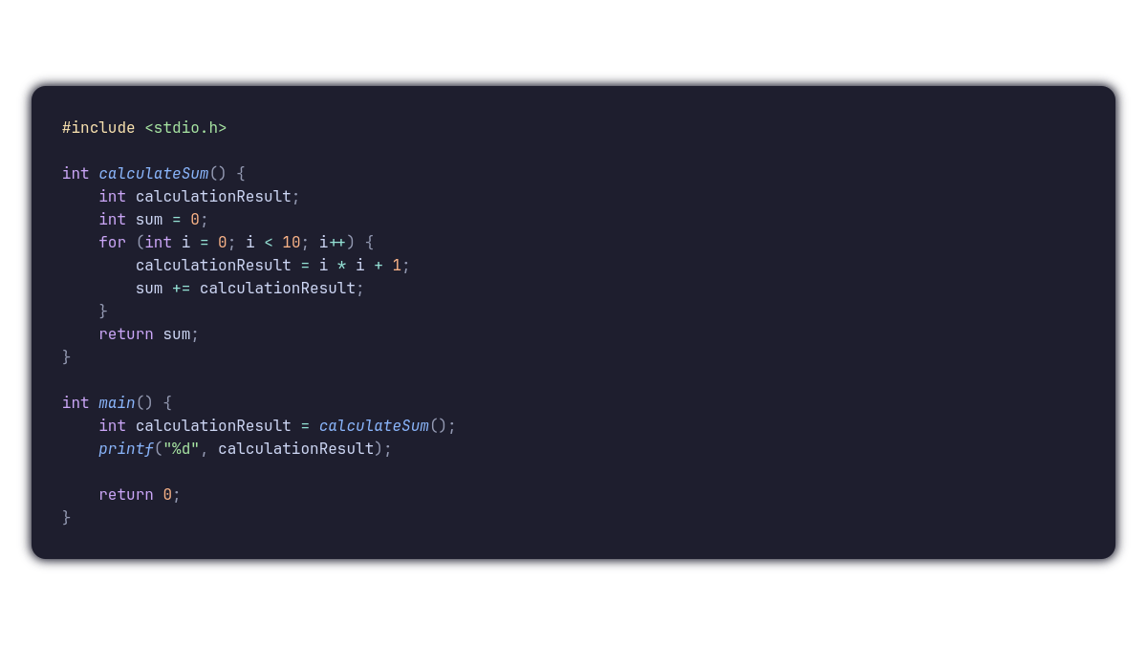
Provided Code

Slide 31
Debugging Demo
Let’s see how we can solve this simple issue using the provided debugger

Slide 32
Tips and Tricks
Enable Debug → Inline Values in your VsCode settings to see the variables at a glance!
Play around with the Debug Console for more power during debugging (will be discussed in the assignment)

Slide 33
Getting started with CLI
What is CLI?
  A text-based approach to interacting with your computer using commands.
Why bother using CLI?
  Much more efficient once mastered
  Less load on the computer compared to GUIs
  Enables easy remote computer management

Slide 34
SSH
SSH, also known as Secure Shell or Secure Socket Shell, is a network protocol that gives users, particularly system administrators, a secure way to access a computer over an unsecured network.
Most administrators prefer this over GUI remote connections due to its simplicity and low bandwidth required.

Slide 35



Shells
Enables you to interact with your operating system and executes commands
Sometimes, it is referred as the command line interpreter
Famous shells include:
  PowerShell
  Bash
  Zsh
  Fish

Slide 36
Command Structures
Commands usually have the following structure
  Command + extra information provided to the program
The extra information might be anything ranging from:
  Path to files
  Numbers, strings, etc.
  Optional options
  ...

Slide 37
Getting started
Shells are usually operated using commands followed by data that is provided to it.
For example, moving around in PowerShell is as easy as executing the following command:
  cd + directory
    cd C:/
    cd kargahFolder

Slide 38

More commands!
Command : cat
  Print the contents of any file to your terminal!

Slide 39
More commands!
Command: dir (ls)
  Get the directories and folders in the current directory.
  Can be given extra options for more info

Slide 40
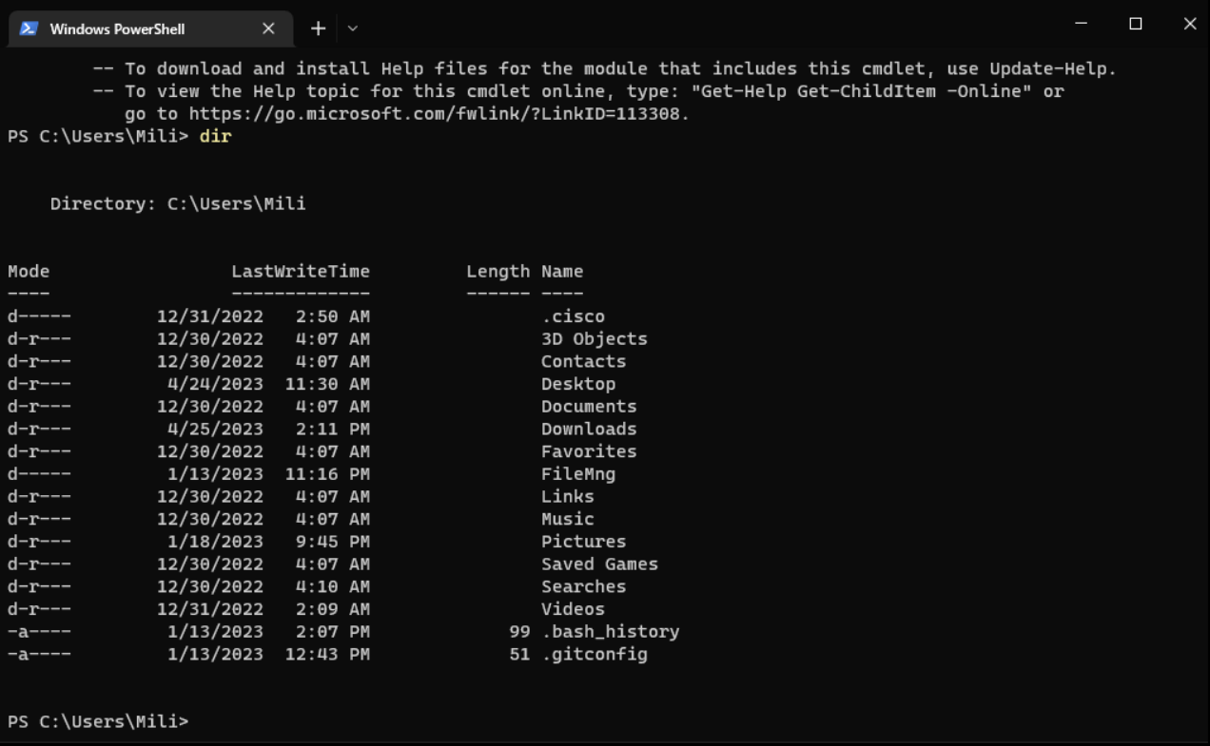

Slide 41
Learn more
Shells usually provide ways to get more information about a command:
  Powershell provides the “help” command
  Linux machines usually include the “man” command
You can use this command by calling the command followed by the name of the command you want to learn about.

Slide 42
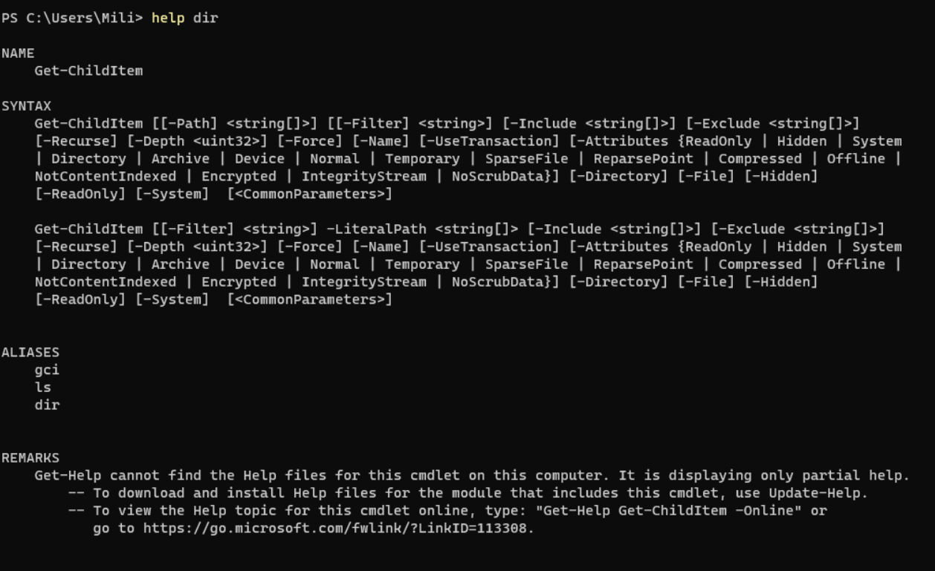

Slide 43
Moving around
The command cd can be used to move around in the terminal and change your current directory.
  The cd command can be used in conjuction with either:
    Relative path: The path with reference to the current location: Desktop
    Absolute Path: The path with reference to root directory:
      C:\Users\Mili\Desktop

Slide 44
Going back
In most shells, there are ways to refer to the current directory and the previous directory:
  Most shells use . (Single Dot) to refer to the current directory
  Most shells also use .. (Double Dot) to refer to the previous directory

Slide 45
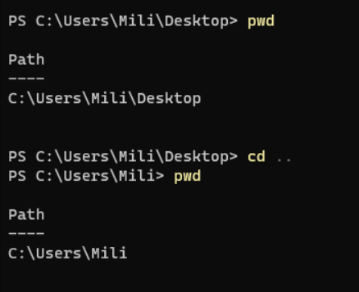
Dots in action
.. (Double Dot) can be used to with the command cd to go to the previous directory!

Slide 46
Learn more commands!
Visit the following website to learn more about basic commands in Powershell!
  https://devblogs.microsoft.com/scripting/table-of-basic-powershell-commands/

